Slide 1
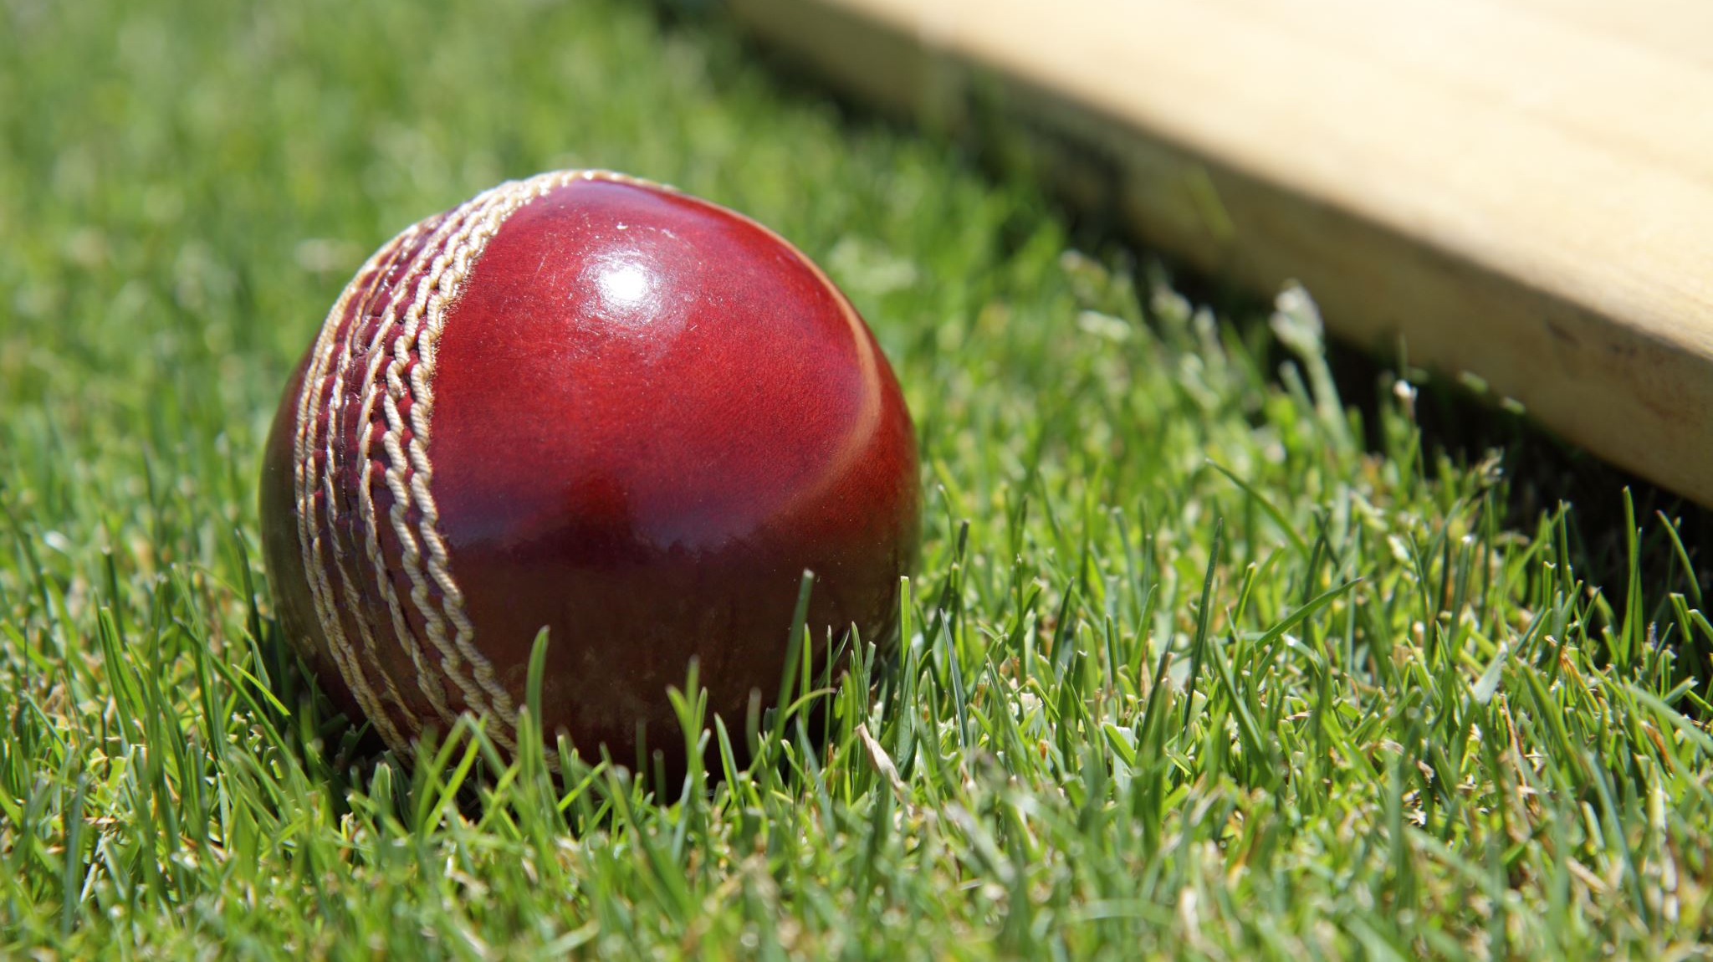
NSCK - Autumn 2021 Review

Slide 2
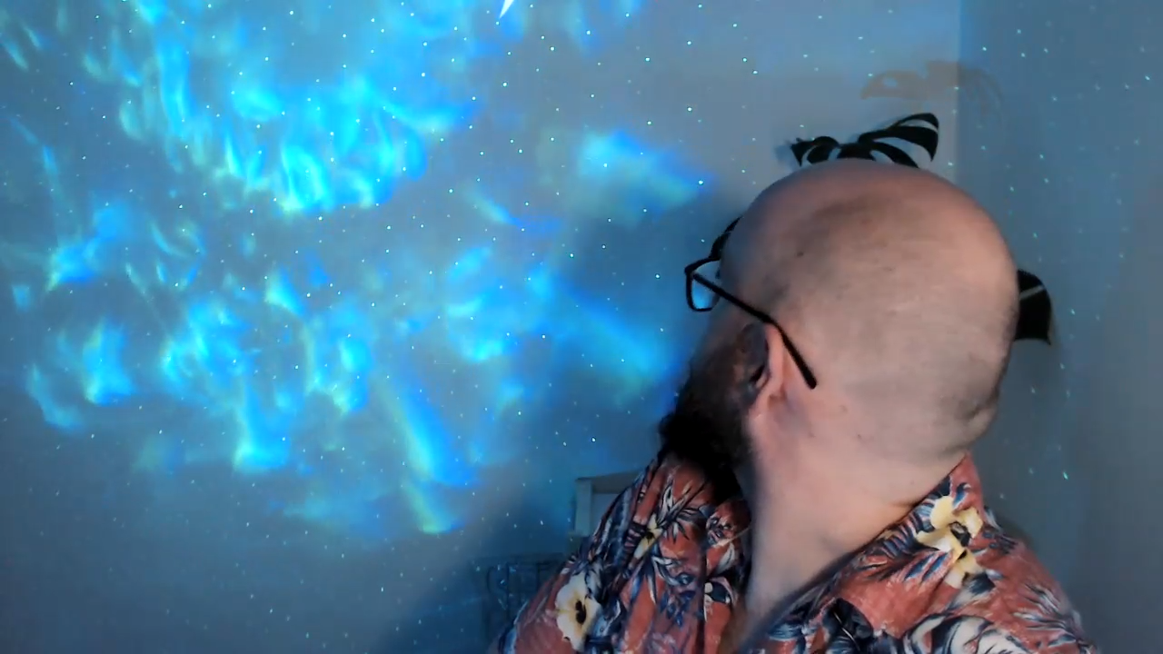
Captains Review

Slide 3
Highlights
Top Score
Fastest Fifty
Best Bowling
Most economical
Russel 90* (47)
Ben – 21 balls
Hemu – 3/17
Peely – 0/6 (4 overs)

Slide 4

Batting Stats
Name | Inns | Runs | HS | Avg | SR
Ronald Victor | 9 | 280 | 54 | 31.1 | 140.0
Jimmy Day | 8 | 271 | 68 | 67.8 | 140.4
Ben Cull | 9 | 137 | 50 | 17.1 | 185.1
Russell Tydens | 3 | 130 | 90 | 65.0 | 168.8
Adam Peel | 9 | 87 | 51 | 10.9 | 122.5
Anas Shafiq | 3 | 59 | 47 | 19.7 | 295.0
Morgan Tear | 8 | 58 | 21 | 14.5 | 74.4
Devin Goheen | 5 | 42 | 25 | 10.5 | 102.4

Slide 5
Bowling Stats
Name | Overs | Runs | Wkts | Econ | Avg | SR
Hemu Bhardwaj | 34.2 | 217 | 10 | 6.3 | 21.7 | 17.1
Adam Peel | 33.0 | 221 | 9 | 6.7 | 24.6 | 18.3
Ronald Victor | 24.0 | 200 | 8 | 8.3 | 25.0 | 15.0
Morgan Tear | 16.9 | 156 | 7 | 9.2 | 22.3 | 12.1
Russell Tydens | 11.0 | 58 | 4 | 5.3 | 14.5 | 13.8
Anas Shafiq | 8.0 | 51 | 2 | 6.4 | 25.5 | 20.0
Ben Cull | 12.0 | 128 | 2 | 10.7 | 64.0 | 30.0

Slide 6
Fielding
Name | Catches | RunOuts
Ronald Victor | 6 | 0
Adam Peel | 2 | 0
Ben Cull | 4 | 1
Hemu Bhardwaj | 1 | 0
Dale Webster | 1 | 0

Slide 7
Keeping
Name | Catches | Stumpings | Byes
Jimmy Day | 5 | 3 | 13
Adam Peel | 2 | 0 | 5
Ben Cull | 0 | 0 | 0
Mike Johnston | 1 | 0 | 0

Slide 8




Vote Count

Slide 9
Match 1 - Result
The Nutty Cuckoo Super Kings - 109/8 (17.0) def by V8s - 110/2 (15.2)
Batting
Jimmy Day - 14 (11)
Rohan Bythell-Douglas - 12 (15)
Pat Danaher - 4 (8)
Bowling
Rohan Bythell-Douglas - 1/25 (2)
Adam Peel - 0/6 (4)
Pat Danaher - 0/13 (2)

Slide 10
Match 1 - Votes
1 votes - Rohan
2 votes - Hemu
3 votes - Pat
4 votes - Jimmy
5 votes - Peely

Slide 11
Match 1 - Leaderboard
name | Votes
Peely | 5
Jimmy | 4
Pat | 3
Hemu | 2
Rohan | 1

Slide 12
Match 2 - Result
Melbourne Dolphins - 151/5 (20.0) defeated The Nutty Cuckoo Super Kings - 124/4 (20.0)
Batting
Dale Webster - 38 (40)
Ronald Victor - 36 (28)
Jimmy Day - 20 (20)
Bowling
Hemu Bhardwaj - 2/18 (3)
Adam Peel - 1/17 (3)
Ronald Victor - 1/22 (3)

Slide 13
Match 2 - Votes
1 votes - Jimmy
2 votes - Dale
3 votes - Hemu
4 votes - Peely
5 votes - Ronnie

Slide 14
Match 2 - Leaderboard
name | Votes
Peely | 9
Hemu | 5
Jimmy | 5
Ronnie | 5
Pat | 3
Dale | 2
Rohan | 1

Slide 15
Match 3 - Result
The Nutty Cuckoo Super Kings - 139/6 (20.0) def by Newport Nellies - 141/7 (17.1)
Batting
Jimmy Day - 68* (43)
Devin Goheen - 25* (10)
Morgan Tear - 15 (21)
Bowling
Ronald Victor - 3/41 (4)
Morgan Tear - 1/11 (2)
Adam Peel - 1/39 (4)

Slide 16
Match 3 - Votes
1 votes - Dev
2 votes - Ben
3 votes - Hemu
4 votes - Ronnie
5 votes - Jimmy

Slide 17
Match 3 - Leaderboard
name | Votes
Jimmy | 10
Peely | 9
Ronnie | 9
Hemu | 8
Pat | 3
Ben | 2
Dale | 2
Dev | 1
Rohan | 1

Slide 18
Match 4 - Result
Mustangs - 150/4 (20.0) defeated The Nutty Cuckoo Super Kings - 128/8 (16.1)
Batting
Ronald Victor - 54 (29)
Ben Cull - 26 (16)
Hemu Bhardwaj - 13 (8)
Bowling
Rahul Anhal - 1/7 (1)
Ben Cull - 1/11 (2)
Hemu Bhardwaj - 1/17 (3)

Slide 19
Match 4 - Votes
1 votes - Anas
2 votes - Dev
3 votes - Hemu
4 votes - Ronnie
5 votes - Ben

Slide 20
Match 4 - Leaderboard
name | Votes
Ronnie | 13
Hemu | 11
Jimmy | 10
Peely | 9
Ben | 7
Dev | 3
Pat | 3
Dale | 2
Anas | 1
Rohan | 1

Slide 21

Bunnoz Award

Slide 22
Match 5 - Result
The Nutty Cuckoo Super Kings - 124/6 (20.0) def by FUCCC Blue - 127/4 (16.2)
Batting
Jimmy Day - 50* (33)
Ronald Victor - 45 (39)
Adam Peel - 11 (10)
Bowling
Adam Peel - 2/20 (4)
Morgan Tear - 2/22 (3)
Hemu Bhardwaj - 0/13 (3)

Slide 23
Match 5 - Votes
1 votes - Ben
2 votes - Ronnie
3 votes - Hemu
4 votes - Jimmy
5 votes - Peely

Slide 24
Match 5 - Leaderboard
name | Votes
Ronnie | 15
Hemu | 14
Jimmy | 14
Peely | 14
Ben | 8
Dev | 3
Pat | 3
Dale | 2
Anas | 1
Rohan | 1

Slide 25
Match 6 - Result
The Nutty Cuckoo Super Kings - 134/5 (20.0) def by V8s - 136/0 (14.0)
Batting
Adam Peel - 51* (36)
Ronald Victor - 23 (6)
Morgan Tear - 21* (30)
Bowling
Ronald Victor - 0/7 (1)
Adarsh Kumar - 0/18 (2)
Morgan Tear - 0/21 (2)

Slide 26
Match 6 - Votes
1 votes - Ben
2 votes - Ronnie
3 votes - Dev
4 votes - Peely
5 votes - Morgs

Slide 27
Match 6 - Leaderboard
name | Votes
Peely | 18
Ronnie | 17
Hemu | 14
Jimmy | 14
Ben | 9
Dev | 6
Morgs | 5
Pat | 3
Dale | 2
Anas | 1
Rohan | 1

Slide 28
Match 7 - Result
FUCCC Blue - 106/7 (19.0) defeated The Nutty Cuckoo Super Kings - 69/8 (11.3)
Batting
Jimmy Day - 23 (23)
Pat Danaher - 16 (17)
Russell Tydens - 10 (8)
Bowling
Hemu Bhardwaj - 3/17 (4)
Adam Peel - 2/14 (4)
Ronald Victor - 1/14 (3)

Slide 29
Match 7 - Votes
1 votes - Russel
2 votes - Pat
3 votes - Jimmy
4 votes - Peely
5 votes - Hemu

Slide 30
Match 7 - Leaderboard
name | Votes
Peely | 22
Hemu | 19
Jimmy | 17
Ronnie | 17
Ben | 9
Dev | 6
Morgs | 5
Pat | 5
Dale | 2
Anas | 1
Rohan | 1
Russel | 1

Slide 31
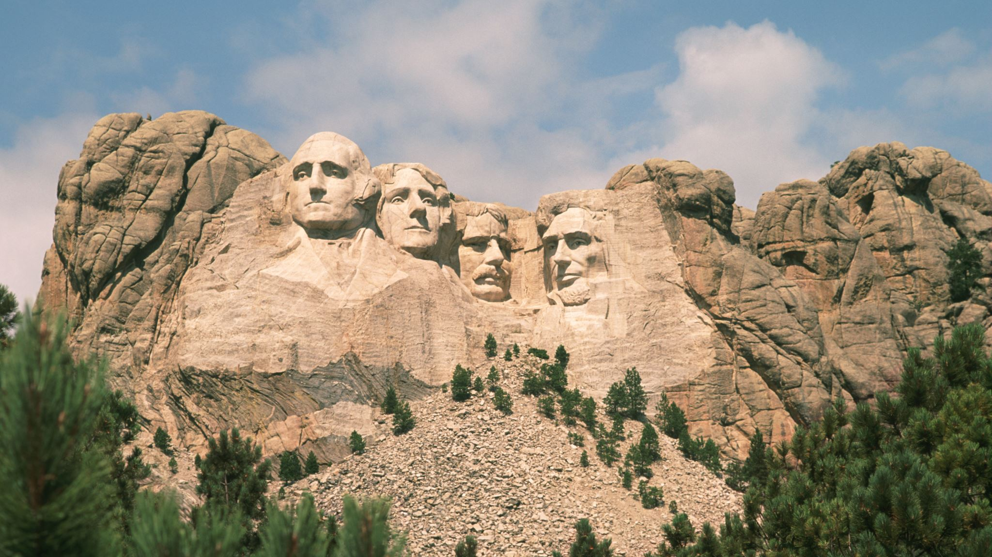
Hall of Fame

Slide 32
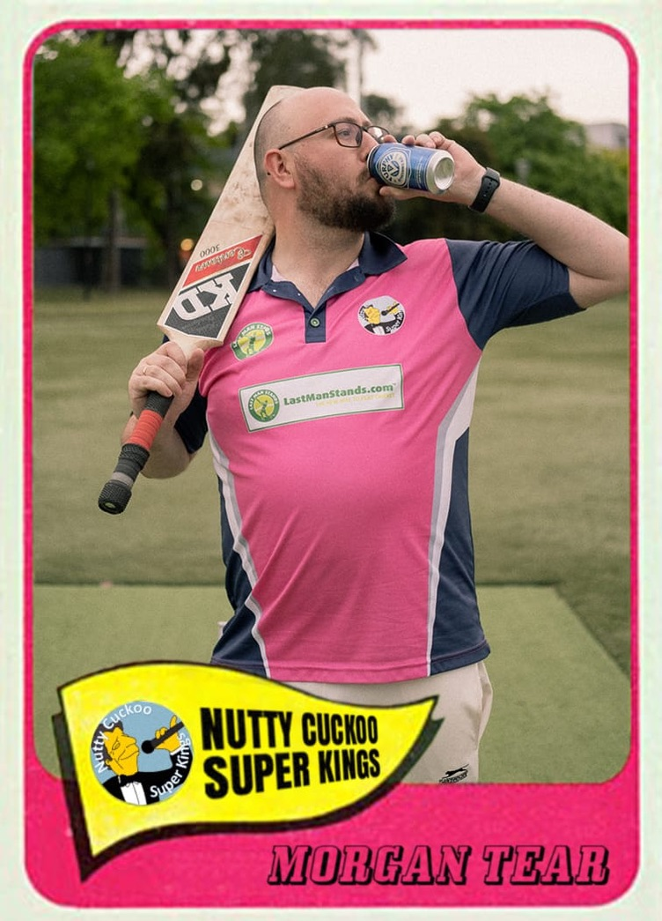
Hall of Fame Inaugural Inductee

Slide 33
Match 8 - Result
The Nutty Cuckoo Super Kings - 174/2 (20.0) def by Melbourne Dolphins - 177/6 (19.3)
Batting
Ben Cull - 50* (21)
Ronald Victor - 50 (38)
Jimmy Day - 37* (18)
Bowling
Russell Tydens - 2/23 (4)
Hemu Bhardwaj - 2/27 (4)
Ronald Victor - 1/24 (3)

Slide 34
Match 8 - Votes
1 votes - Jimmy
2 votes - Russel
3 votes - Hemu
4 votes - Ronnie
5 votes - Ben

Slide 35
Match 8 - Leaderboard
name | Votes
Hemu | 22
Peely | 22
Ronnie | 21
Jimmy | 18
Ben | 14
Dev | 6
Morgs | 5
Pat | 5
Russel | 3
Dale | 2
Anas | 1
Rohan | 1

Slide 36
Match 9 - Result
The Nutty Cuckoo Super Kings - 172/5 (20.0) defeated Mustangs - 135/8 (17.3)
Batting
Jimmy Day - 52* (37)
Anas Shafiq - 47 (16)
Ronald Victor - 25 (18)
Bowling
Morgan Tear - 2/5 (1)
Ben Cull - 1/20 (2)
Hemu Bhardwaj - 1/27 (4)

Slide 37
Match 9 - Votes
1 votes - Pat
2 votes - Morgs
3 votes - Anas
4 votes - Ben
5 votes - Jimmy

Slide 38
Match 9 - Leaderboard
name | Votes
Jimmy | 23
Hemu | 22
Peely | 22
Ronnie | 21
Ben | 18
Morgs | 7
Dev | 6
Pat | 6
Anas | 4
Russel | 3
Dale | 2
Rohan | 1

Slide 39
Match 10 - Result
Newport Nellies - 175/7 (18.3) defeated The Nutty Cuckoo Super Kings - 153/7 (20.0)
Batting
Russell Tydens - 90* (47)
Ronald Victor - 31 (24)
Ben Cull - 8 (5)
Bowling
Russell Tydens - 2/22 (4)
Adam Peel - 2/26 (3)
Ronald Victor - 1/27 (3)

Slide 40
Match 10 - Votes
1 votes - Jimmy
2 votes - Peely
3 votes - Ronnie
4 votes - Morgs
5 votes - Russel

Slide 41
Match 10 - Leaderboard
name | Votes
Jimmy | 24
Peely | 24
Ronnie | 24
Hemu | 22
Ben | 18
Morgs | 11
Russel | 8
Dev | 6
Pat | 6
Anas | 4
Dale | 2
Rohan | 1

Slide 42
Golden Furphy Winners

Slide 43
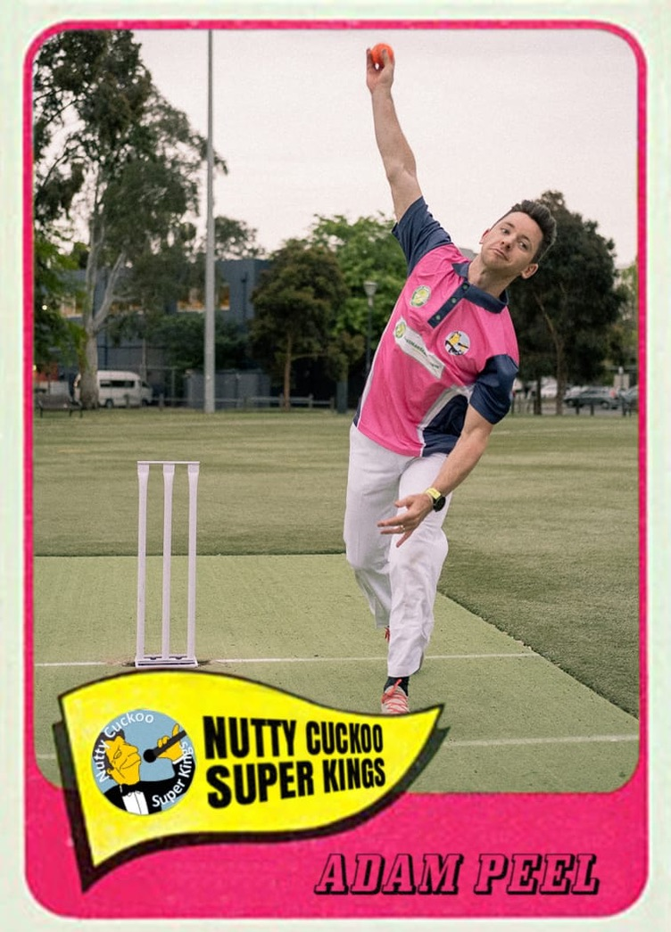
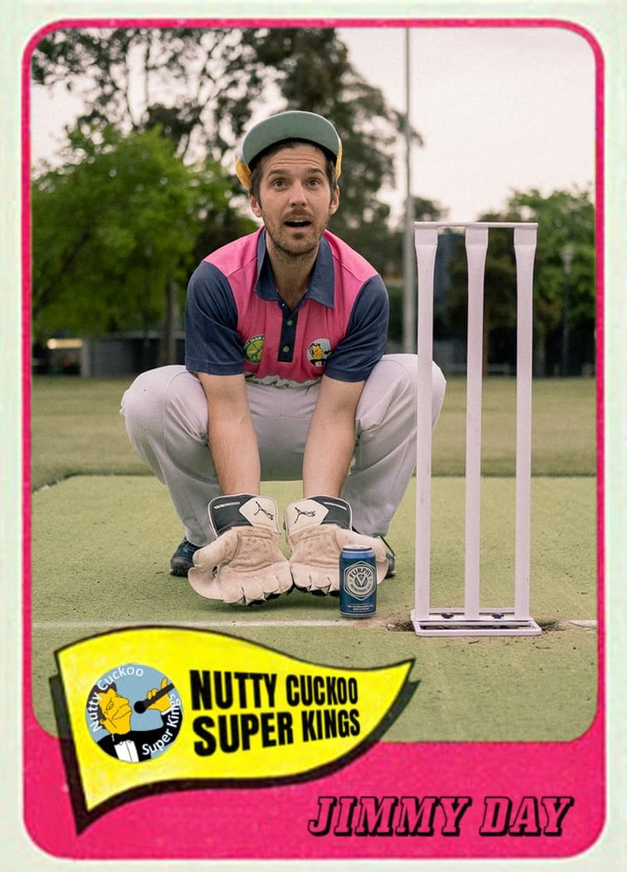

Golden Furphy – Autumn 2021

